Slide 1
UI with jdi easy fast good

Slide 2


ROMAN IOVLEV
Chief QA Automation
In Testing more than 11 years
In Testing Automation 9 years
Notes:
Работаю в компании Epam в

Slide 3
?

Slide 4





Jdi setup
https://github.com/epam/JDI
http://jdi.epam.com/
https://vk.com/jdi_framework
README

Slide 5

Jdi setup
Maven, Gradle, Ivy
<dependency>
<groupId>com.epam.jdi</groupId>
<artifactId>jdi-uitest-web</artifactId>
<version>1.0.58</version>
</dependency>
https://github.com/epam/JDI-Examples
https://github.com/epam/JDI
README

Slide 6
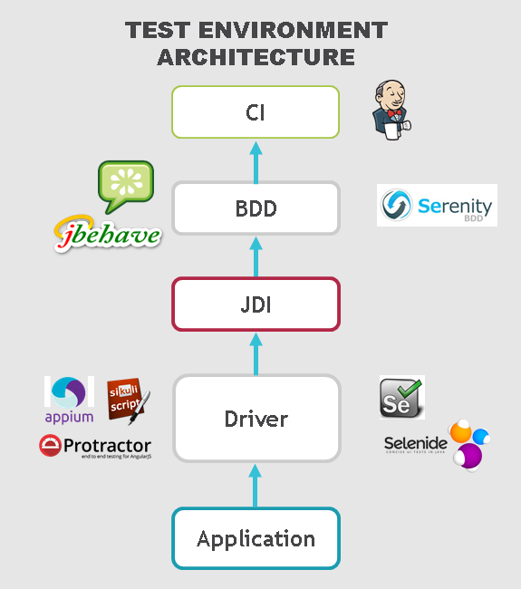
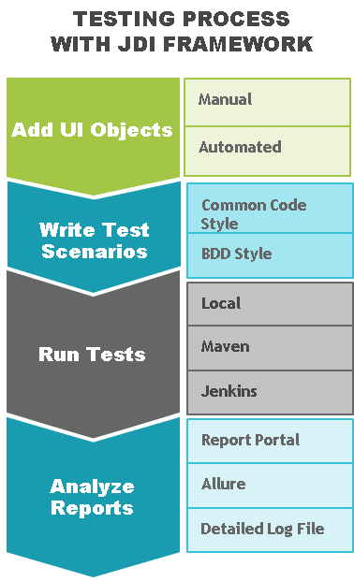
FAQ

Slide 7
SIMPLE TEST
ProductPage.ProductType.Select(«jacket»);
ProductPage.Price.select(«500$»);
ProductPage.Colors.check(«black», «white»);
Assert.isTrue(ProductPage.Label.getText(),
«Armani Jacket»)

Slide 8
SIMPLE TEST
LoginPage.Open();
LoginPage.LoginForm.Login(admin);
SearchPage.Search.Find(«Cup»);
Assert.AreEqual(ResultsPage.Products.Count(), expected);

Slide 9
Page elements

Slide 10
Tests
Page Objects
Driver (Engine)
Application
PAGE OBJECTS
ELEMENTS
private WebElement UserName; private WebElement Password; private WebElement LoginButton;
ACTIONS
EnterUserName(String name);
EnterPassword(String name);
ClickLoginButton();
BUSINESS ACTIONS
Login(User user)

Slide 11
PAGE ELEMENTS
ELEMENTS
public TextField UserName; public TextField Password; public Button LoginButton;
ELEMENT
public DropDown UserStatus;
ACTIONS
Select(string option)
bool IsSelcted()
List<string> AllOptions()
string GetValue()
ACTIONS
---
BUSINESS ACTIONS
Login(User user)

Slide 12
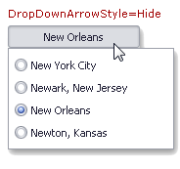
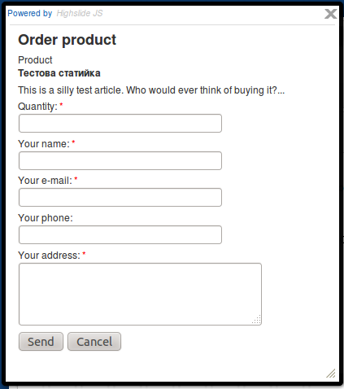

ELEMENTS
Simple
Complex
Composite

Slide 13
Simple elements

Slide 14


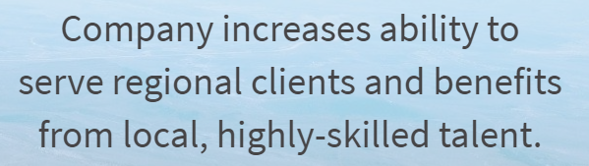
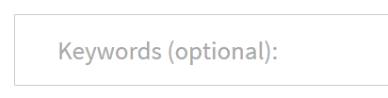
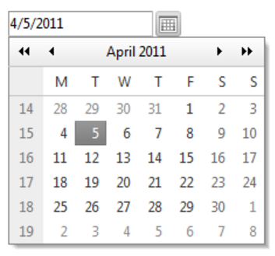

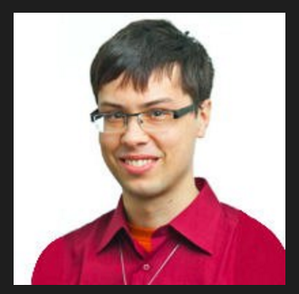

SIMPLE ELEMENTS
@FindBy (css=“.description”)
public Text description;
public Button submit;
public Label productName;
public Link followMe;
public TextField password;
public TextArea abuse;
public CheckBox rememberMe;
public DatePicker date;
public FileInput upload;
public Image photo;
NEWS

Slide 15

SIMPLE ELEMENTS
@FindBy (css=“.btn”)
public Button submit;
@FindBy (css=“.btn”)
@FindBy (xpath=“//button”)
@FindBy (id=“button-id”)
@FindBy (name=“button”)
@FindBy (css=“.btn”)
public Button submit =
new Button(By.css(“.btn”));
@JFindBy (text=“Submit”)
@JFindBy (model=“btn-model”)
@JFindBy (binding=“btn”)
@JFindBy (repeater=“r-button”)
@FindBy (css=“.btn”)
public IButton submit;

Slide 16
Multilocators
Multi language testing
Multi version testing
@JFindBy (text=“Submit”, group=“en”)
@JFindBy (text=“Отправить” , group=“ru”)
public Button submit;
@JFindBy (text=“Submit”, group=“1.7”)
@JFindBy (value=“Submit” , group=“2.0”)
public Button submit;

Slide 17


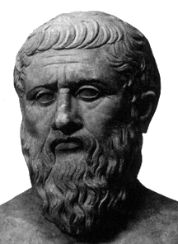

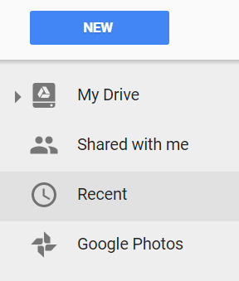

Plato's theory of Forms
IButton
No application but you can write UI Objects (Page Objects )
Notes:
Why we develop it?
Some people formulate it as “Why you create one more wheel”

Slide 18
complex elements

Slide 19
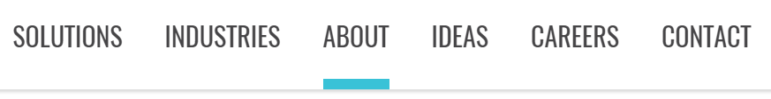
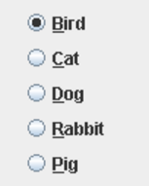
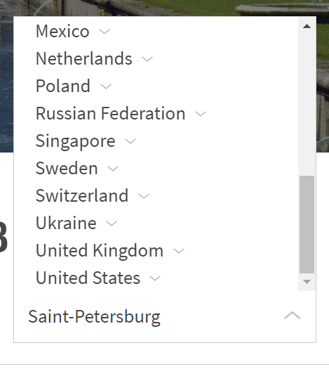
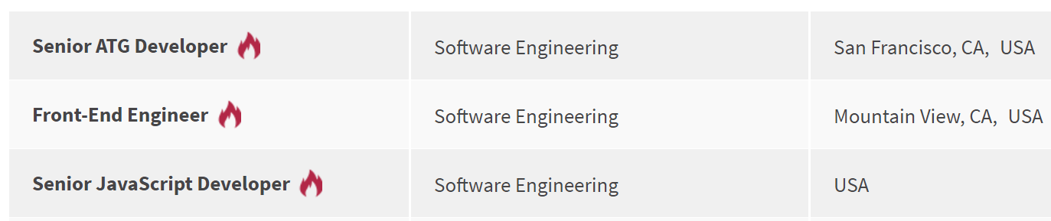
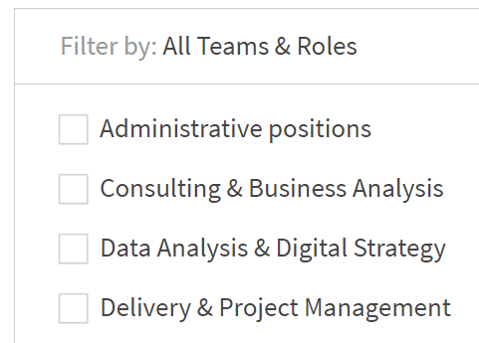
COMPLEX ELEMENTS
public Dropdown colors;
public Checklist settings;
public ComboBox tags;
public DropList shirtSizes;
public List<Element> searchResults;
public Elements reviews;
public Table products;
public Menu mainMenu;
public Tabs areas;
public Selector vote;
public RadioButtons rating;
public TextList chat;

Slide 20
COMPLEX ELEMENTS
@JDropdown (
root = @FindBy(css = “.colors"),
value = @FindBy(css = “.value"),
elementByName = @FindBy(tagName = “li"))
public Dropdown colors;
@JTable(
root = @FindBy (css = “.offers"),
row = @FindBy (xpath = ".//li[%s]//div"),
column = @FindBy (xpath = ".//li//div[%s]"),
header = {“ID", “Title", “Apply”} )
public Table offers;

Slide 21
COMPLEX ELEMENTS
@FindBy(css = “.colors")
public Dropdown colors;
@FindBy(css = “.table”)
public Table offers;
@FindBy(css = “.menu li”)
public Menu navigation;
@FindBy(css = “.menu ul”)
public Menu navigation;
@FindBy(xpath = “//*[@class=‘menu’]//li[text()=‘%s’]”)
public Menu navigation;

Slide 22
Using enums

Slide 23
Enums in Complex elements
public Menu<Options> topMenu;
public enum Options {
Home, About, Contacts }
topMenu.select(Options.About);
topMenu.select(About);
public Dropdown<Colors> colors;
public Tabs<Areas> areas;
public Checklist<Settings> settings;
public ComboBox<Tags> tags;
public DropList<Sizes> shirtSizes;
public Selector<VoteOptions> vote;
public RadioButtons<Ratings> rating;
public enum Options {
Home(‘option-1’),
About(‘option-3’),
public String value;
Options (String value) { this.value = value; }
@Override
public String toString() { return value; }
}

Slide 24
TYPIFIED ELEMENTS
Code readability
Clear behavior
Union of all element’s locators
Union of element and its actions
Detailed logging

Slide 25
COMPARE
Text Description;
Button Submit;
Label ProductName;
Link FollowMe;
TextField Password;
TextArea Abuse;
CheckBox RememberMe;
DatePicker Date;
FileInput Upload;
Image Photo;
WebElement Description;
WebElement SubmitButton;
WebElement ProductName;
WebElement FollowMeLink;
WebElement PasswordField;
WebElement Abuse;
WebElement RememberMe;
WebElement DatePicker;
WebElement Upload;
WebElement Photo;

Slide 26
COMPARE
@JDropdown (root = @FindBy(css = “.colors"),
value = @FindBy(css = “.value"),
elementByName = @FindBy(tagName = “li"))
Dropdown Colors;
@FindBy(css = “.colors .value")
WebElement ColorsValue;
@FindBy(css = “.colors li")
List<WebElement> ColorsList;
public string getColor() {
return ColorsValue.getText();
}
public void selectColor(string colorName) {
ColorsValue.Click();
for (WebElement color : ColorsList)
if (color.getText().Equals(colorName) {
color.Click();
return;
}
}

Slide 27
COMPARE
@FindBy (id = “trades")
public Table Colors;
@FindBy(css = "")
private List<WebElement> resultsColHeaders;
@FindBy(css = "")
private List<WebElement> resultsRowsHeaders;
@FindBy(css = "")
private List<WebElement> resultsCellsHeaders;
@FindBy(css = "")
private List<WebElement> resultsColumn;
@FindBy(css = "")
private List<WebElement> resultsRow;
ICell cell(Column column, Row row) { }
ICell cell(String columnName, String rowName) { }
ICell cell(int columnIndex, int rowIndex) { }
List<ICell> cells(String value) { }
List<ICell> cellsMatch(String regex) { }
ICell cell(String value) { }
ICell cellMatch(String regex) { }
MapArray<String, MapArray<String, ICell>> rows(String... colNameValues) { }
MapArray<String, MapArray<String, ICell>> columns(String... rowNameValues) { }
boolean waitValue(String value, Row row) { }
boolean waitValue(String value, Column column) { }
boolean isEmpty() { }
boolean waitHaveRows() { }
boolean waitRows(int count) { }
ICell cell(String value, Row row) { }
ICell cell(String value, Column column) { }
List<ICell> cellsMatch(String regex, Row row) { }
List<ICell> cellsMatch(String regex, Column column) { }
MapArray<String, ICell> row(String value, Column column) { }
MapArray<String, ICell> column(String value, Row row) { }
MapArray<String, ICell> row(int rowNum) { }
MapArray<String, ICell> row(String rowName) { }
List<String> rowValue(int colNum) { }
List<String> rowValue(String colName) { }
MapArray<String, ICell> column(int colNum) { }
MapArray<String, ICell> column(String colName) { }
List<String> columnValue(int colNum) { }
List<String> columnValue(String colName) { }
MapArray<String, SelectElement> header() { }
SelectElement header(String name) { }
List<String> headers() { }
List<String> footer() { }
List<ICell> getCells() { }
void clean() { }
void clear() { }
ITable useCache(boolean value) { }
ITable useCache() { }
Table clone() { }
Table copy() { }
ITable hasAllHeaders() { }
ITable hasNoHeaders() { }
ITable hasOnlyColumnHeaders() { }
ITable hasOnlyRowHeaders() { }
ITable hasColumnHeaders(List<String> value) { }
<THeaders extends Enum> ITable hasColumnHeaders(Class<THeaders> headers) { }
ITable hasRowHeaders(List<String> value) { }
<THeaders extends Enum> ITable hasRowHeaders(Class<THeaders> headers) { }
ITable setColumnsCount(int value) { }
ITable setRowsCount(int value) { }

Slide 28
Composite elements

Slide 29
composite Elements
public class Header extends Section
@JPage(url = "/index.html", title = “Good site")
public class HomePage extends WebPage
@JSite(domain = “http://epam.com/")
public class EpamSite extends WebSite
public class LoginForm extends Form
public class SearchBar extends Search
public class Alert extends Popup
public class Navigation extends Pagination

Slide 30
Test properties
driver=chrome
timeout.wait.element=10
domain=https://www.epam.com/
driver.getLatest=true
$ mvn install -Dbrowser=firefox -Ddomain=http://…
driver=${browser}
domain=${domain}
…

Slide 31
WEB site
@JSite(domain = “http://epam.com/")
public class EpamSite extends WebSite {
@JPage(url = "/index.html")
public static HomePage homepage;
@JPage(url = "/login", title = “Login page")
public static LoginPage loginPage;
@FindBy (css=“.nav”)
public static Menu navigation;
}
@BeforeSuite(alwaysRun = true)
public static void setUp() {
WebSite.init(EpamSite.class);
}

Slide 32
WEB PAGE
@JPage(url = "/main", title = "Good site", urlTemplate = “/main?\d{10}“, urlCheckType = MATCH, titleCheckType = CONTAINS)
public class HomePage extends WebPage
USAGE
homepage.open();
homepage.checkOpened();
homepage.isOpened();
homepage.refresh();
homepage.back();
homepage.forward();
homepage.addCookie();
homepage.clearCache();

Slide 33
Section
public class Header extends Section {
@FindBy (css=“.submit”)
public Button submit;
@FindBy (css=“.followMe”)
public Link followMe;
@FindBy (css=“.navigation”)
public Menu navigation;
public void openAbout() {
followMe.Click();
navigation.select(ABOUT);
}
}
USAGE
header.submit.Click();
header.menu.isSelected();
header.openAbout();

Slide 34
Entity driven testing

Slide 35






EDT: DATA DRIVEN TESTING
Provide List<User> for test

Slide 36


EDT: PRECONDITIONS
Provide List<User> for test
0. Have DefaultUser in DB
?
+

Slide 37

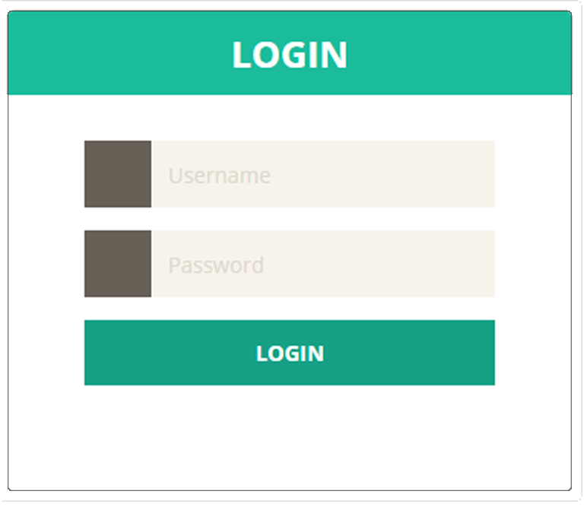
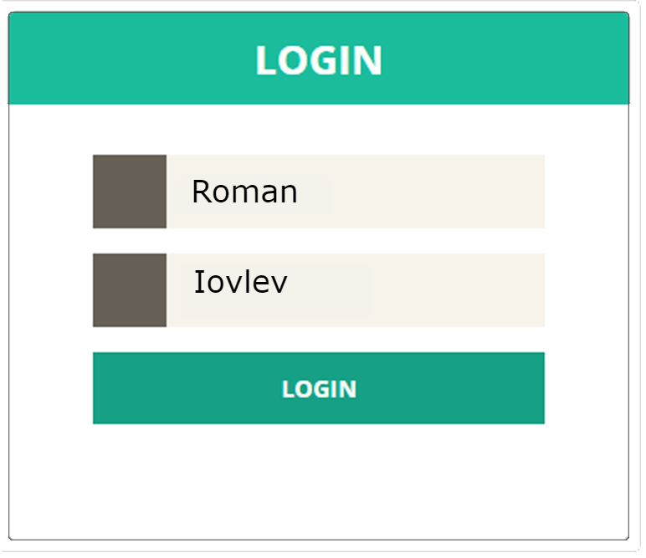
EDT: FILL AND SUBMIT
Provide List<User> for test
0. Have DefaultUser in DB
Login with DefaultUser

Slide 38

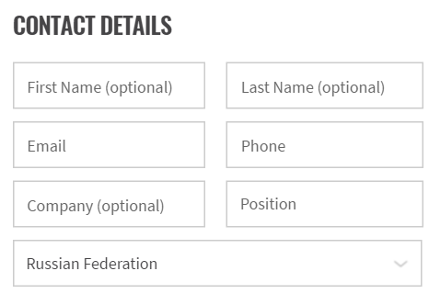
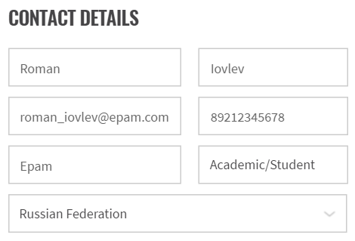
EDT: FILL AND SEND
Provide List<User> for test
0. Have DefaultUser in DB
Login with DefaultUser
Submit Contact Us Form for DefaultUser

Slide 39

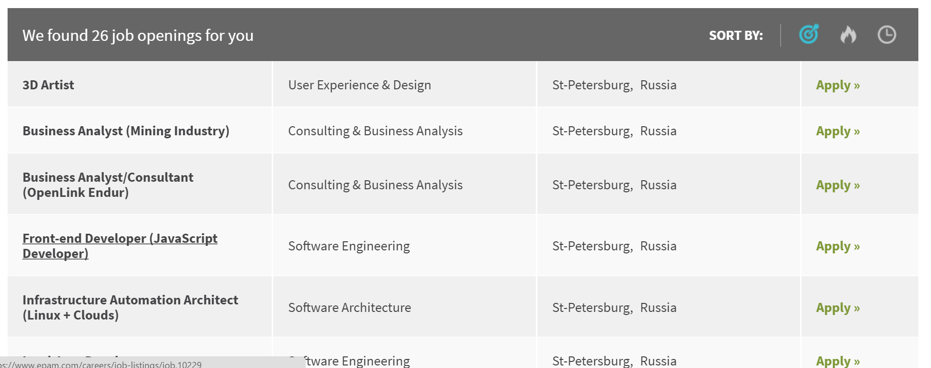

EDT: EXTRACT
Provide List<User> for test
0. Have DefaultUser in DB
Login with DefaultUser
Submit Contact Us Form for DefaultUser
Get Act. Opening from Vacancy table

Slide 40

EDT: VALIDATE
Provide List<User> for test
0. Have DefaultUser in DB
Login with DefaultUser
Submit Contact Us Form for DefaultUser
Get Act. Opening from Vacancy table
Assert Act. Opening equals to Exp. Opening
Actual
Expected

Slide 41
FORM
public class LoginForm extends Form<User> {
@FindBy (css=“.login”)
public TextField login;
@FindBy (css=“.psw”)
public TextField password;
@FindBy (css=“.submit”)
public Button submit;
@FindBy (css=“.cancel”)
public Button cancel;
}
public class User {
public String login = “roman”;
public String password = null;
}
@Test
public class simpleTest(User user) {
loginForm.login(user);
…
}

Slide 42
Entity driven testing
@Test
public void formTest(User admin) {
loginForm.loginAs(admin);
filter.select(admin.name);
Assert.each(results).contains(admin.name);
results.get(1);
payForm.submit(admin.creditCard);
Assert.areEquals(DB.Transactions.get(1),
admin.creditCard);
}
USAGE
loginForm.fill(user);
loginForm.submit(user);
loginForm.verify(user);
loginForm.check(user);
loginForm.cancel(user);
loginForm.save(user);
loginForm.publish(user);
loginForm.search(user);
loginForm.update(user);
…

Slide 43
@JTable(
root = @FindBy(className = "search-result-list"),
row = @FindBy(xpath = ".//li[%s]//div"),
column = @FindBy(xpath = ".//li//div[%s]"),
header = {"name", "category", "location", "apply"})
public EntityTable<Job, JobRecord> jobs =
new EntityTable<>(Job.class, JobRecord.class);

Slide 44
Entity tables
JobsRow job = jobsPage.jobs.firstRow(r ->
textOf(r.title).equals(“Senior QA Engineer”) &&
textOf(r.location).equals(“Saint-Petersburg”))
job.apply.agree.click();
List<Job> jobs = jobsPage.jobs.entites();
Assert.entitiesAreEquals(jobs, expectedJobs);

Slide 45
elements
@FindBy(css = ".list.ui-sortable")
public Elements<FilmCard> filmCards;
filmCards.get(name).title.getText();
Assert.listEquals(filmCards.asData(Film.class), films);

Slide 46
Other UI objects
public class SearchBar extends Search { }
public class Navigation extends Pagination { }
public class Confirmation extends Popup { }
…
public class MyCustom extends CustomObject { }
// implements IComposite

Slide 47
Ui objects pattern

Slide 48

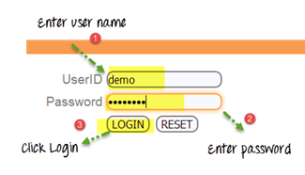
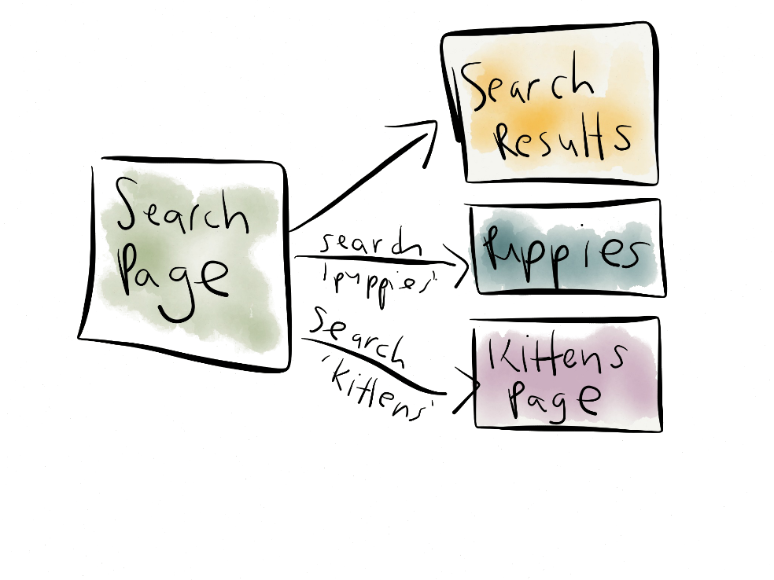
UI Objects
Popular test pattern
Page Objects

Slide 49
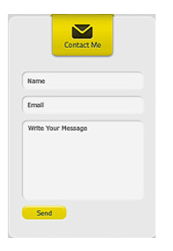


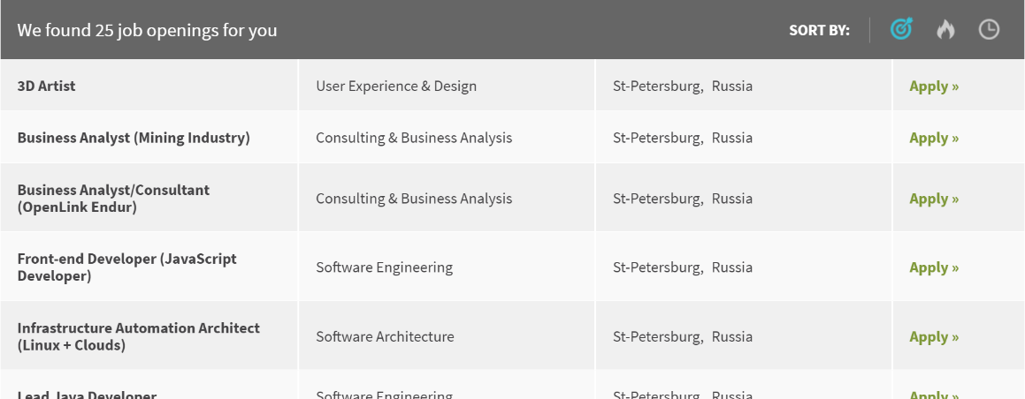
UI Objects
Useful test approach
UI Elements

Slide 50



UI Objects
Flexible implementation
Interfaces

Slide 51
UI Objects
Page Objects
UI Elements
UI OBJECTS
Interfaces

Slide 52
Test settings

Slide 53
Test properties
driver=chrome
timeout.wait.element=10
domain=https://www.epam.com/
driver.getLatest=true
search.element.strategy=strict | soft
browser.size=1800X1000
demo.mode=false | true
log.message.format = short
run.type=local | remote
cache=false
screenshot.strategy=on fail | on | off
mvn cmd parametres
driver=${browser}
domain=${domain}
…

Slide 54
SETTINGS
DRIVER
DEMO
driver=chrome | firefox | ie
drivers.version=2.23
driver.getLatest=true
browser.size=1800X1000 | max | full
driver.path=C:\\Selenium
demo.mode=false | true
demo.delay=2
SCREENSHOTS
elements
screenshot.strategy=
on fail | on | off
timeout.wait.element=10
log.message.format=short | full
cache=false | true

Slide 55
SETTINGS
SEARCH ELEMENT
search.element.strategy=strict | soft | visible, multiple | any, single
visible - accept only visible elements;
any - accepts any elements found
single - if found more than 1 element > throw error
multiple - if found more than 1 element > takes first element
strict = visible, single
soft = any, multiple

Slide 56
logger

Slide 57
log4g
Log4J
log4j.rootLogger = info, console
log4j.appender.console = org.apache.log4j.ConsoleAppender
log4j.appender.console.layout = org.apache.log4j.PatternLayout
log4j.appender.console.layout.ConversionPattern = %m%n
log4j.rootLogger = debug|error, file, HTML, dailylog
log4j.appender.file=org.apache.log4j.RollingFileAppender
log4j.appender.file.File=target/.logs/events.log
log4j.appender.file.layout.ConversionPattern= %d{yyyy-MM-dd HH:mm:ss} %-5p %c{1}:%L - %m%n
log4j.appender.file.layout=org.apache.log4j.PatternLayout

Slide 58
Logging jdi
JDISettings.logger = SuperLogger.Logger();
logger.info(“Start tests”);
colors.select(BLUE);
[Info] 10:20.154 Start tests
[Info] 10:20.220 Select Blue for Selector ‘Colors' (.Selector; css=‘.colors')
[Debug] 10:21.004 Get web element for Clickable 'Clickable' (.Clickable; css=‘.colors’)
[Debug] 10:21.932 Done

Slide 59
Log in bdd style
ProductPage.ProductType.select(«jacket»);
ProductPage.Price.select(«500$»);
ProductPage.Colors.check(«black», «white»);
I select ‘jacket’ ProductType on ProductPage
I select ‘500$’ Price on ProductPage
I check ‘black’ and ‘white’ Colors on ProductPage

Slide 60
structure

Slide 61
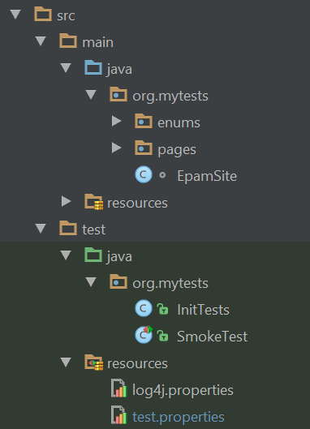
structure
test.properties
log properties
ui objects
test init
tests

Slide 62
CUSTOMIzATION

Slide 63
Custom actions
public Dropdown<Types> productTypes
= new Dropdown<Types>() {
@Override
public void selectAction(String name) {
super.selectAction(name);
label.click();
}
};

Slide 64
Custom elements
public class TreeDropdown<T extends Enum> extends Dropdown<T> {
…
@Override
protected void selectAction(String name) {
expandAction();
String[] nodes = name.split(" > ");
SearchContext context = getDriver();
if (treeLocators.size() >= nodes.length)
for (int i=0; i < nodes.length; i++) {
String value = nodes[i];
context = first(context.findElements(treeLocators.get(i)),
el -> el.getText().equals(value));
new Clickable((WebElement) context).click();
}
}
}

Slide 65
Custom scenarios
@BeforeSuite (alwaysRun = true)
public static void setUp() {
ActionScenrios.actionScenario = (element, actionName, jAction, level) -> {
logger.info(format("Do '%s' action", actionName));
jAction.invoke();
};
ActionScenrios.resultScenario = (element, actionName, jAction, logResult, level) -> {
logger.debug(format("Do '%s' action", actionName));
Object result = jAction.get();
logger.info(format("Get '%s' action result: %s", actionName, result));
return result;
};
}

Slide 66
Stable search
public boolean wait(BooleanSupplier waitCase) {
while (!timeoutPassed())
try {
if (waitCase.getAsBoolean())
return true;
sleep(retryTimeoutInMSec);
} catch (Exception ex) {throw new Exception(ex); }
…
}

Slide 67
Element search
@BeforeSuite (alwaysRun = true)
public static void setUp() {
SeleniumDriverFactory.elementSearchCriteria =
el -> el.isEnabled() && el.isDisplayed();
// el -> el != null;
};
@Test()
public void simpleTest() {
sumResult.avatar.localElementSearchCriteria
= el -> !el.getAttribute(“display”).equals(“none”);
};

Slide 68
PRECONDITIONS

Slide 69
No test dependencies
@Test(dependsOnMethods = “loginTest”)
public void simpleTest() {
…
};
@Test(dependsOnGroups = “smoke”)
public void simpleTest() {
…
};

Slide 70
preconditions
Independent tests
Time optimization
JDI Page precondition
homePage.isOpened();
PRECONDITION
JDI State precondition
IsInStateCheckAction
MoveToStateAction
PreconditionsState.isInState(LOGGED_IN)
or
isInState(LOGGED_IN)

Slide 71
preconditions
public enum Preconditions implements IPreconditions {
CALC_INIT(() -> calculator.value == 0,
() -> { calculator.clear();
calculator.clearMemeory() }),
CAREERS_PAGE("/careers");
….
}

Slide 72

Demo: preconditions
Notes:
Demo Элементы на UI

Slide 73
matchers

Slide 74
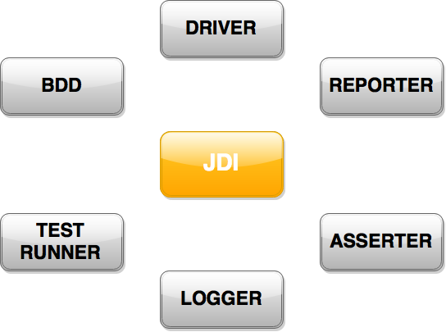
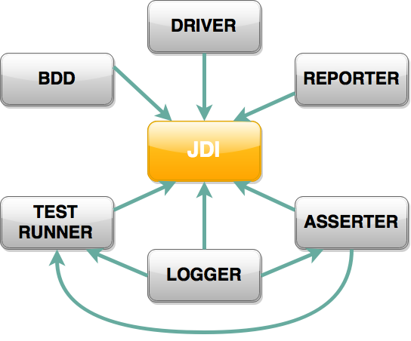

MODULE structure

Slide 75
matchers
Assert.contains("Test Text", "Text");
Assert.matches("1352-423-85746", "\\d{4}-\\d{3}-\\d{5}");
Assert.arrayEquals(searchResults, expectedResults);
Assert.listEquals(orders, expectedOrders);
Assert.each(searchResults).contains("IPhone");
Assert.each(searchResults).matches("IPhone \\d.*");
Assert.areEquals(() -> getNext(), "IPhone 6");
Assert.contains(() -> getNext(), "IPhone 5")
Assert.throwException(this::request, “Bad Request");
Assert.hasNoExceptions(this:: request);

Slide 76
matchers
new Check(“Search results are correct”)
.listEquals(searchResults, expectedResults);
ScreenAssert.matches("1352-423-85746", "\\d{4}-\\d{3}-\\d{5}");
Assert.ignoreCase().areEquals(result, "IPhone 6");
Assert.waitTimeout(2).contains(() -> result, "IPhone");
Assert.doScreenshot(SCREEN_ON_FAIL).isTrue(2 * 2 == 4);
Assert.fail(“Houston we have a problem”);
throw Assert.exception(“Something goes wrong”);

Slide 77
interfaces

Slide 78




Test Any UI
Selenium
<dependency>
<groupId>com.epam.jdi</groupId>
<artifactId>jdi-uitest-web</artifactId>
<version>1.0.39</version>
</dependency>
Your Engine (Driver)
Appium
<dependency>
<groupId>com.epam.jdi</groupId>
<artifactId>jdi-uitest-mobile</artifactId>
<version>1.0.39</version>
</dependency>
Sikuli / Winnium
<dependency>
<groupId>com.epam.jdi</groupId>
<artifactId>jdi-uitest-gui</artifactId>
<version>1.0.39</version>
</dependency>

Slide 79
JDI architecture
Commons
Matchers
IElement
ISelector
IComposite
IPage
IHasValue
ISetValue
Core
Web, Mobile, Gui …
IButton
ICheckBox
IDatePicker
IFileInput
IImage
ILabel
ILink
IText
ITextArea
ITextField
ICheckList
IComboBox
IDropDown
IDropList
IForm
IGroup
IMenu
IPage
IPagination
IPopup
IRadioButtons
ISearch
ISelector
ITabs
ITextList
INTERFACES
public interface ICheckBox
extends IClickable, ISetValue {
void check();
void uncheck();
boolean isChecked();
}

Slide 80
interfaces
public class Header extends Section {
@FindBy (css=“.submit”)
public IButton submit;
@FindBy (css=“.followMe”)
public ILink followMe;
@FindBy (css=“.navigation”)
public IMenu navigation;
}
MapInterfaceToElement.update(
new Object[][] {
{ IDropDown.class, MyDropDown.class},
{ IButton.class, MyButton.class},
{ ITable.class, CustomTable.class}
});

Slide 81
Parallel test run

Slide 82

parallel test run
<?xml version="1.0" encoding="WINDOWS-1251"?>
<!DOCTYPE suite SYSTEM "http://testng.org/testng-1.0.dtd">
<suite name="Test suite" parallel="methods" thread-count="2">
<test name="Tests" preserve-order="true">
<classes>
<class name="com.epam.jdi.uitests.testing.simple.examples.TableExamples"/>
<class name="com.epam.jdi.uitests.testing.career.common.tests.CareerTests"/>
<class name="com.epam.jdi.uitests.testing.simple.examples.FormExamples"/>
</classes>
</test>
</suite>

Slide 83
instruction

Slide 84
First run
Download project template from Github
https://github.com/epam/JDI link
“Simple Java example project” In Readme
Add (replace examples) UI objects for your project in src/main/…/uiobjects
Add tests in src/test/…/tests
Add DataProviders in src/test/…/dataproviders
Cover your tests with data providers

Slide 85
instruction
Setup project settings in:
test.properties
log4j.properties
InitTests
Add your tests running in CI (e.g. Jenkins) using maven cmd line. Add different test runs with parameters in CI if you need this
Create parallel tests run(s) using testng xml
put them in src/test/resources

Slide 86
For business

Slide 87
JDI benefits
Write test code faster up to 5 times
Average result around 2.8 times
4.7 times speedup on the project with standard implementation
Produce less amount of test code (loc) up to 3 times
Average result around 2.1 times
2.8 times reduction on the project with standard implementation
Achieve higher clearness of tests
Decrease of support time for test projects
Lowering of project entry barrier for newcomers
Complete projects with higher quality
Based on 70 % answers in survey

Slide 88
JDI benefits
Reuse investments from one Project on another
Based on 5 years of work and more than 30 projects that already use JDI
Save up to 80% test effort by migrating tests to other Platforms
Based estimated average scope reductions for all test process stages
Example: migrate Web tests to Mobile platform
Can be used in most of projects with UI Automation
Actually we have no projects where JDI is not applicable. The only reason why not all of our projects use JDI is Client requirements
Save up to 30-40% money from whole test process
Based on average calculation of scope reductions for all test process stages

Slide 89
FUTURE

Slide 90
Log in bdd style
ProductPage.ProductType.select(«jacket»);
ProductPage.Price.select(«500$»);
ProductPage.Colors.check(«black», «white»);
I select ‘jacket’ ProductType on ProductPage
I select ‘500$’ Price on ProductPage
I check ‘black’ and ‘white’ Colors on ProductPage

Slide 91
Generated page objects
Chrome plugin
Get ui elements to page object in browser
Auto generation
public class LoginForm extends Form<User> {
@FindBy (css=“.login”)
public TextField login;
@FindBy (css=“.psw”)
public TextField password;
@FindBy (css=“.submit”)
public Button login;
}

Slide 92
Services page objects
@ServiceDomain(“http://service.com”)
public class ServiceExample {
@GET (“/color/get”)
public RestMethod getColor;
@POST (“/color/change/100”)
public RestMethod changeColor;
}
Auto generation by WSDL

Slide 93
db testing support

Slide 94


simple tests generator

Slide 95




Support main ui dev frameworks

Slide 96

Performance / statistic

Slide 97

Sniff http requests

Slide 98


Support js / phyton

Slide 99
Good practices

Slide 100
remember
Test Scenarios should be clear for understanding. Every man can read and understand them (client, test engineer, analyst):
Move all things not related to scenario out in separate modules. Common test parts move in to before/after test. Combine 3 or more asserts followed one by one in one step check
Limit your test scenarios with 10-15 lines. Test class with 150-200. In other case You can logically split your test classes in to several suits with high chances
Tests names should clearly say about their essence
Each test scenario line should represent one business step
All test checks/asserts should be in test scenario as step. You should not hide them in to steps

Slide 101
remember
Test scenarios are useless without right test infrastructure:
Tests should run on regular basement on CI. Your test scenarios should be ready to get settings from command line (environment domain, test group, browser etc.)
Test suit should work stable on stable build. If some tests falls randomly. You must fix them or temporarily remove them from test suit
Tests should represent all info about test run in suitable format. They should provide detailed enough log about scenario steps and provide visible reports

Slide 102
remember
Tests should be independent. Each test should be run separetly. Use preconditions in order to move test to expected state. Tests should not disturb one to another. If some tests should use common data then move them in separate group
Never use ThreadSleep. Wait some application state (page load, end of ajax…) or next element appearance instead
Use your brain and get pleasure from testing. If automation testing not make you happy possibly you doing something wrong. Think about it

Slide 103

enjoy

Slide 104




Contacts
UI Objects
typified Elements
typified Objects
Entity Driven testing
Interfaces
http://jdi.epam.com/
https://vk.com/jdi_framework
https://github.com/epam/JDI
roman.Iovlev
roman_iovlev@epam.com

